Slide 1
Project Title Job Check – Detecting Fake Job Posts

Slide 2
Data Loading, Data Preprocessing, Splitting The Data, Data Training And Data Testing.
Milestone 2
The project was carried out collaboratively by:
Athul
Hari Priya
Harshapriya
Shakthi Saravanan

Slide 3
Objective
To classify job postings as real or fraudulent by applying Natural Language Processing (NLP) techniques and a Machine Learning model for text classification.
Dataset Overview
Source: Dataset Source : Kaggle - Job Detection Dataset
Size: 25,788 job postings
Features: 10 attributes describing job details (e.g., title, description, requirements, company profile, benefits, industry).

Slide 4
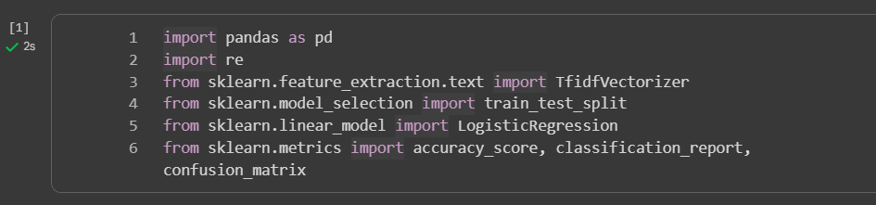
Step 1 : Importing Libraries
Pandas : For loading and handling tabular data (Data Frames).
re (regular expressions) : For text cleaning (removing HTML tags, URLs, special characters).
TF-IDF Vectorizer : Converts text data into numerical vectors using TF-IDF (Term Frequency–Inverse Document Frequency).
Train/Test Split : Splits the dataset into training and testing sets.
LogisticRegression : Machine Learning model for classification.
Accuracy score, Classification report, Confusion matrix : Metrics to evaluate model performance.

Slide 5
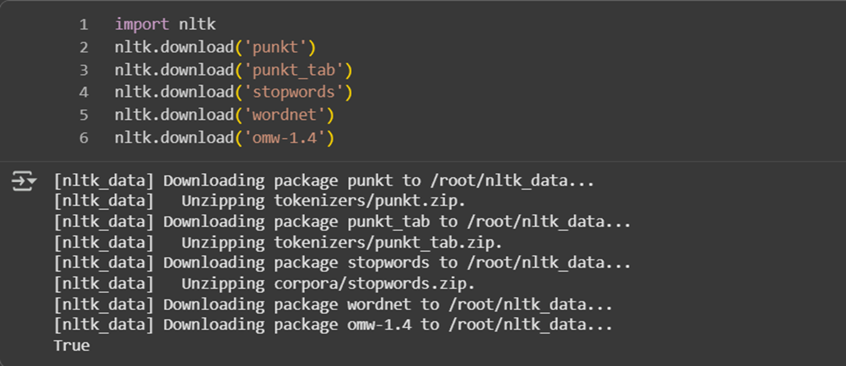
Step 2: Downloading NLTK Resources
punkt : Tokenizer models (splits text into words).
punkt_tab : Additional tokenizer resources.
stopwords : Common words like “the”, “and” to remove from text.
wordnet & omw-1.4 : For lemmatization (reducing words to their base form).

Slide 6
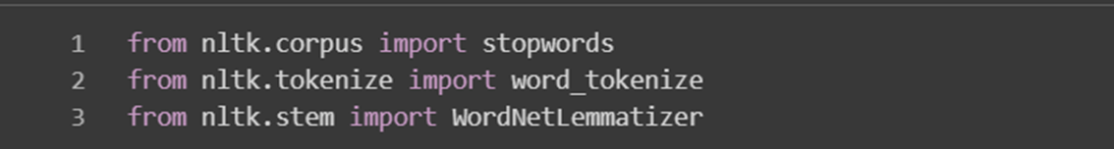
Step 3: Importing NLTK Modules
NLTK (Natural Language Toolkit) : A Python library for Natural Language Processing(NLP).
It is used for Breaking down and analysing human language (text)
stopwords : Provides list of common words to remove.
Word_tokenize :Splits sentences into words (tokens).
WordNetLemmatizer : Converts words to their base or root form.

Slide 7
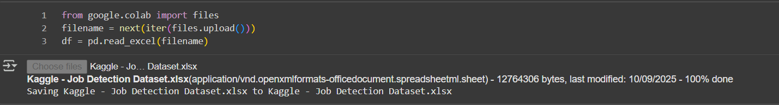
Data Collection
Step 4 : Uploading Dataset
Dataset is read into a pandas Data Frame using pd.read_excel( )

Slide 8
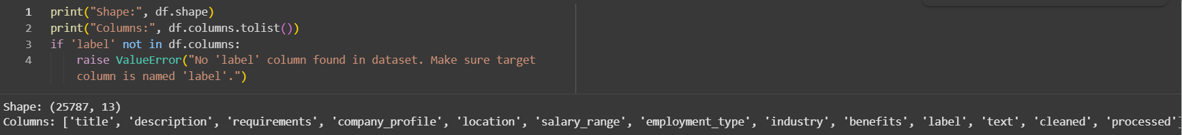
Data Loading
Step 5 : Basic checks (shape, columns)
df.shape : Shows number of rows and columns.
df.columns.tolist() : Lists all column names.
Checks if target column 'label' exists. If not raises an error.

Slide 9
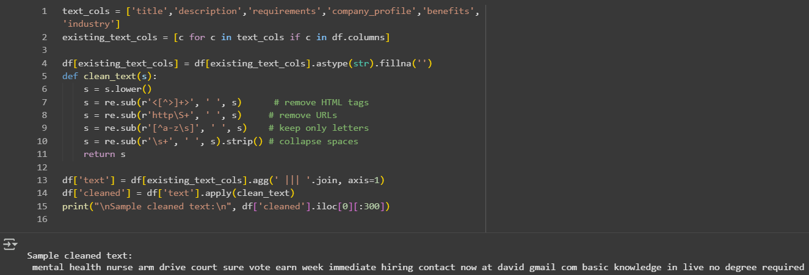
Data Preprocessing

Slide 10
Step 6 : Cleaning , Functioning and Combining Text Columns
Selects only text columns that exist in dataset.
Converts missing values to empty strings.
Lowercasing : Makes text uniform.
HTML & URL removal : Cleans text of tags/links.
Special character removal : Keeps only letters.
Whitespace normalization : Removes extra spaces.
Combines multiple text columns into single column 'text' using ||| as separator.
Applies clean_text() to produce 'cleaned' column.

Slide 11
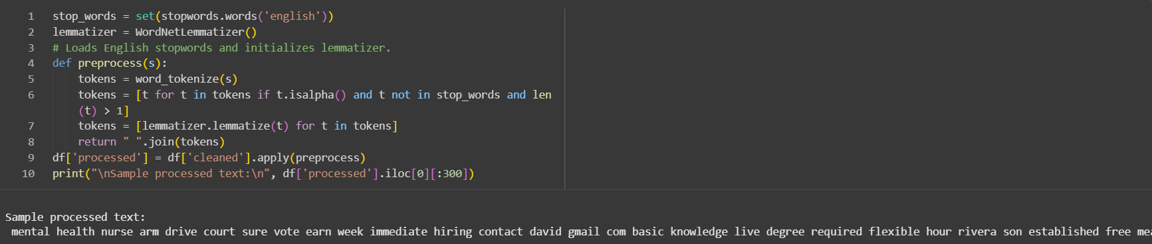
Step 7 : Preprocessing
Tokenization : Break text into words.
Remove stopwords & short words : Keeps meaningful words only.
Lemmatization : Converts words to base form (running → run).
Join tokens back : Final cleaned text in 'processed' column.

Slide 12
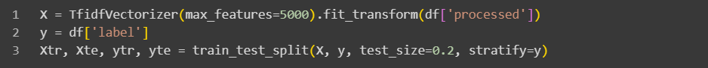
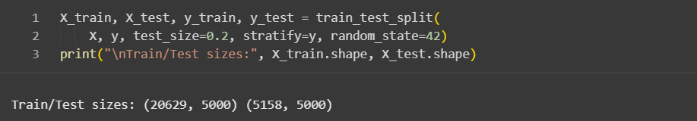
Step 8 : Vectorization (TF/IDF)
Converts text into numerical features using TF-IDF.
max_features=5000 → Keeps top 5000 important words.
y → Target labels (real/fake).
Step 9 : Train/Test Split

Slide 13

Splits data into 80% training and 20% testing.
Stratify=y → Keeps same label distribution in train and test.
Data Training
Step 10 : Training the Model
Initializes Logistic Regression classifier.
Fits the model on training data (X_train,Y_train)

Slide 14
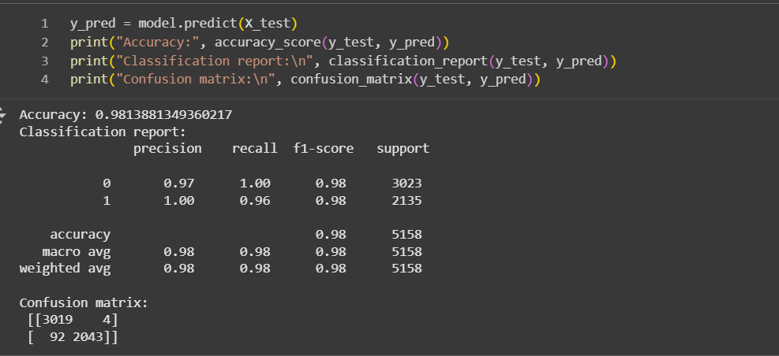
Data Testing / Model Evaluation
Step 11 : Testing & Evaluation

Slide 15
Model Evaluation
Accuracy
Overall Accuracy: 98%
Indicates the model correctly classified almost all job postings as real or fake.
Classification Report (Summary)
Class 0 : Most real jobs detected correctly.
Class 1 : Most fake jobs detected correctly.
F1-score 0.98 : Excellent balance between precision and recall.
Confusion Matrix
Correctly classified → 5062 out of 5158 jobs.
Misclassified → Only 96 jobs (≈1.9%).

Slide 16
THANK YOU

